Slide 1
JOOUST DEANS ELECTION 2020

Slide 2
ChoiceVoting
About ChoiceVoting
ChoiceVoting is a company based in the UK that provides an online voting software that can be used to create elections and get instant results at the close of elections.
ChoiceVoting has for 15 Years worked with Student Unions, Universities, Schools, charities and Business to enable them to manage unlimited Online Voting elections.

Slide 3
Who else is using it?
AECC University
Students Union at Bounesmouth University
Virginia State of America Foundation
e.t.c
Security
ChoiceVoting uses a 256-Bit Encryption SSL to secure Elections and Ballots.

Slide 4
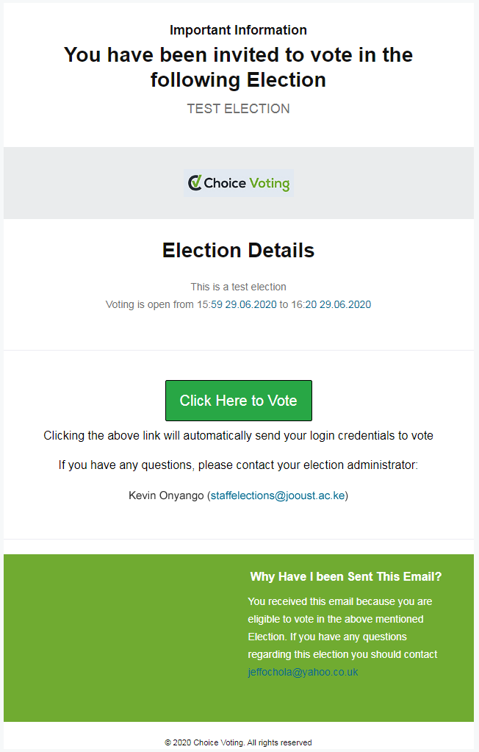
Voting Procedure
A Voters List will be created for each school and confirmed by the voters, candidate and elections board.
The list will be converted into a csv file and imported/ uploaded into the Choice Voting System.
The upload will be confirmed by the returning officer.
The voter will receive a link (sent to their emails) inviting them to vote 30mins to 1Hour before the beginning of voting.

Slide 5
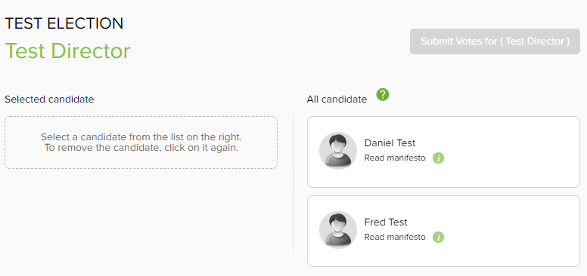
Voting Procedure
e) On clicking the link, the voter will be taken to a login page where they will be able to login to the election page

Slide 6
Voting Procedure
f) The voter will then select the candidate of their preference and submit their vote.
g) Upon close of voting, the system shall automatically tally the results which shall then be accessed and viewed by the returning officer in the presence of agents and the election board.
h) The election results will only be available to the voters, agents, returning officer and the elections board after the close of voting.

Slide 7
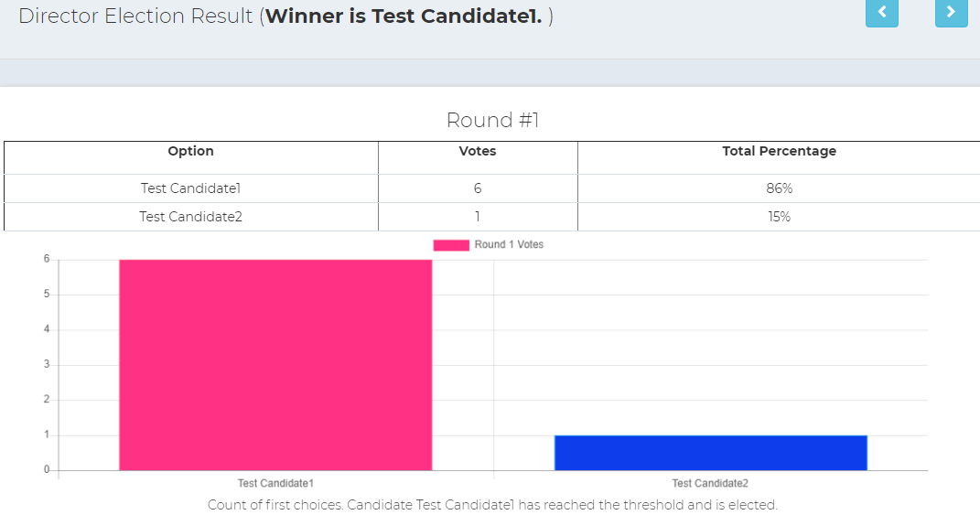
Election Result

Slide 8
THANKS

